Slide 1
Analyzing New York City(NYC)
to open an Indian Restaurant

Slide 2
Business Problem
The City of New York, is the most populous city in the United States. The five boroughs – Brooklyn, Queens, Manhattan, The Bronx, and Staten Island – were consolidated into a single city in 1898. The New York City region is home to the largest Indian American population among metropolitan areas by a significant margin, enumerating 711,174 uniracial individuals by the 2013-2017 U.S. Census American Community Survey estimates.
Of course, food and service are important to the success of a restaurant, but the location can be just as crucial. There need to be enough people who live in or pass through the area regularly to keep our business busy. This shows how important it is to start a restaurant in an area which is easily accessible and where you can attract your targeted audience easily. We analyze the neighborhoods in New York City to identify the most profitable area.

Slide 3
Data Acquisition:
New York City has a total of 5 boroughs and 306 neighborhoods. In order to segment the neighborhoods and explore them, we will essentially need a dataset that contains the 5 boroughs and the neighborhoods that exist in each borough as well as the latitude and longitude coordinates of each neighborhood. Use https://cocl.us/new_york_dataset to get all the information about the neighborhoods present in New York City.
To get the information about New York City: https://en.wikipedia.org/wiki/New_York_City
To get the information about densely populated area with Indians: https://en.wikipedia.org/wiki/Indians_in_the_New_York_City_metropolitan_region#Demographics
The Foursquare Places API provides location based experiences with diverse information about venues, users, photos, and check-ins. To search for a specific type of venues, to explore a particular venue, to explore a Foursquare user, to explore a geographical location, and to get trending venues around a location in New York City we use (https://developer.foursquare.com/docs)

Slide 4
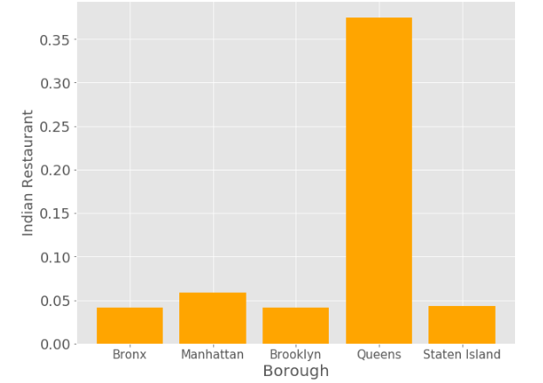
Methodologies: Indian Restaurant in 5 boroughs

Slide 5
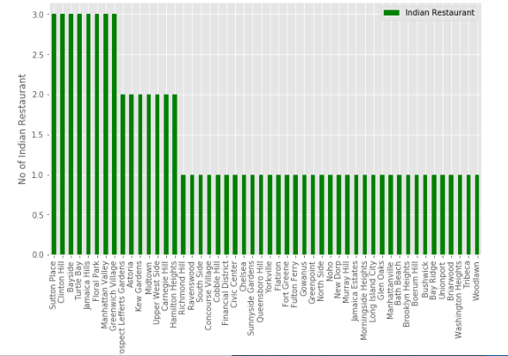
Neighborhoods Vs Indian Restaurant

Slide 6
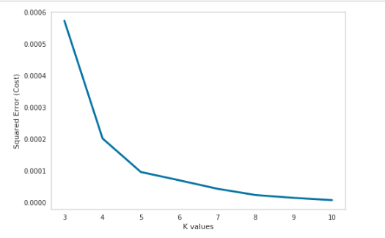
Classification Models:
a) Clustering Neighborhoods of New York City
First step in K-means clustering is to identify best K value meaning the number of clusters in a given dataset.

Slide 7
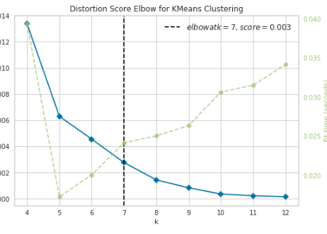
From this visualizer it is clear that 7 is the best value.
Run k-means to cluster the neighborhood into 7 clusters.

Slide 8
Result:
In the result section we can document all the findings from above clustering & visualization of the data. In this project, we started the business problem with identifying a good neighborhood to open a new Indian restaurant, we looked into all the neighborhoods in New York City, analyzed the Indian population in each neighborhood & spread of Indian restaurants in those neighborhoods to come to conclusion about which neighborhood would be a better spot for opening a new Indian restaurant.
With the help of clusters examining & Bar chart looks like Queens , Manhattan, Brooklyn are already densely populated with Indian restaurants. So it is better idea to leave those boroughs out and consider only Bronx and Staten Island for the new Indian restaurant's location.
After careful consideration it is a good idea to open a new Indian restaurant in Bronx borough since it has high number of Indian population compared to Staten Island which gives a higher number of customers possibility and lower competition since very less Indian restaurants in the Bronx neighborhoods.
So, Bronx borough is a perfect place for starting a good and quality Indian Restaurant.

Slide 9
Future Improvement
The population density of Indians is based on the 2014 Americans Census. Thus population distribution or density would have changed by 2019.
We made the analysis only based on the 5 boroughs population, i.e., it is not based on the neighborhoods density of Indian population. So, if we have that too definitely we will give much more exact report to open an Indian Restaurant.
Since population distribution of Indian crowd in each neighborhood & number of Indian restaurants are the major feature in this analysis and it is not fully up-to date data, this analysis is definitely not far from being conclusory & it has lot of areas where it can be improved. However, it certainly provides us with some good insights, preliminary information on possibilities & a head start into this business problem by setting the step stones properly. Furthermore, this may also potentially vary depending on the type of clustering techniques that we use to examine the data.

Slide 10
Conclusion:
This study will help and give more information to:
Indian peoples who wants to know about the neighborhood Indian Restaurants.
Business personnel who wants to invest or open an Indian Restaurant in New York City.
Similar to this analysis, we can choose any scenario such as analyzing which venues are popularly visited by the people, their rating, and some of the other popular neighborhoods that surrounds one place etc.,

